Slide 1

Project On
Ecommerce Electronic Products
Sales Forecasting System
PYTHON PROGRAMMING (INT 213)

Slide 2
SCHOOL OF COMPUTER SCIENCE & ENGINEERING
NAME OF UNIVERSITY -
LOVELY PROFESSIONAL UNIVERSITY
DATE OF SUBMISSION - 7th December 2021
FACULTY - Mr. Ishan Kumar

Slide 3

Team
NAME (REGISTRATION NUMBER) Aprendu Aman (12016997 )
Contribution : Coding
NAME (REGISTRATION NUMBER) Aryaman Suri (12016990)
Contribution : Report
NAME (REGISTRATION NUMBER) Shivam Hooda (12016991)
Contribution : Presentation

Slide 4
What is Sales Forecasting ?
Sales forecasting is the process of estimating future revenue by predicting the amount of product or services a sales unit (which can be an individual salesperson, a sales team, or a company) will sell in the next week, month, quarter, or year.

Slide 5
Why is Sales Forecasting
Important ?
A sales forecast helps every business make better business decisions. It helps in overall business planning, budgeting, and risk management. ... Sales forecasting also helps businesses to estimate their costs and revenue accurately based on which they are able to predict their short-term and long-term performance

Slide 6
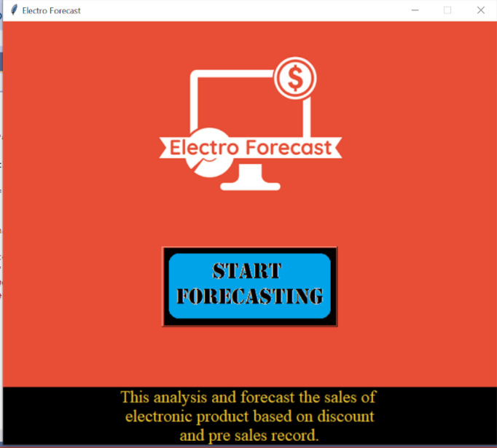
The Project
Click here
Home Screen /Opening Interface

Slide 7
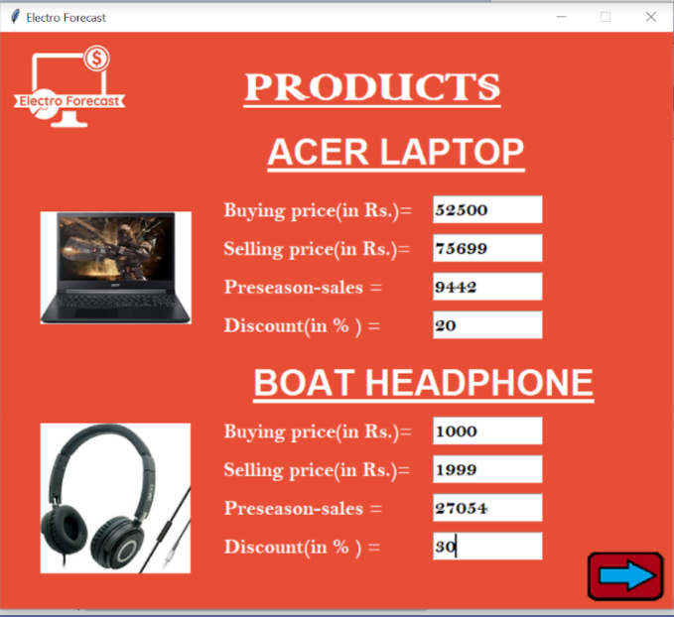
Space for entering data of product
Click here to see more products
Products Details

Slide 8
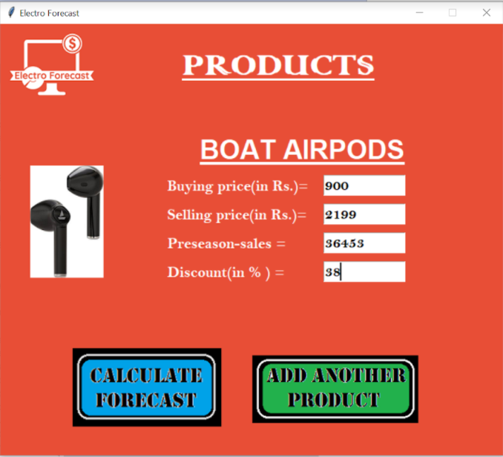
Options for adding more products
Click to start forecasting

Slide 9
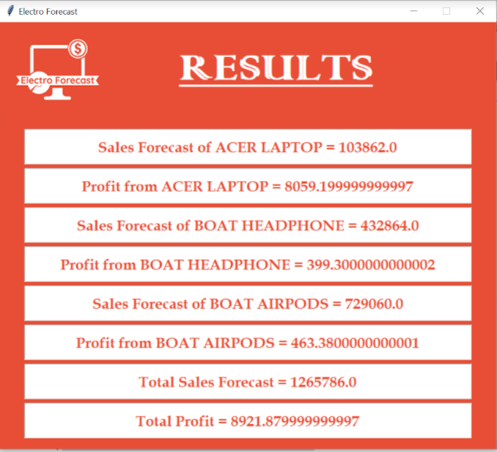
Final Result after calculation

Slide 10
Formulae used
Profit = Selling price – ((discount/100)*sales)-Buying price
Forecast =Sales + (discount/2)*sales

Slide 11
Concept used of Python
Python offers multiple options for developing GUI (Graphical User Interface). Out of all the GUI methods, tkinter is the most commonly used method. It is a standard Python interface to the Tk GUI toolkit shipped with Python. Python with tkinter is the fastest and easiest way to create the GUI applications.

Slide 12


References

Slide 13


